Slide 1
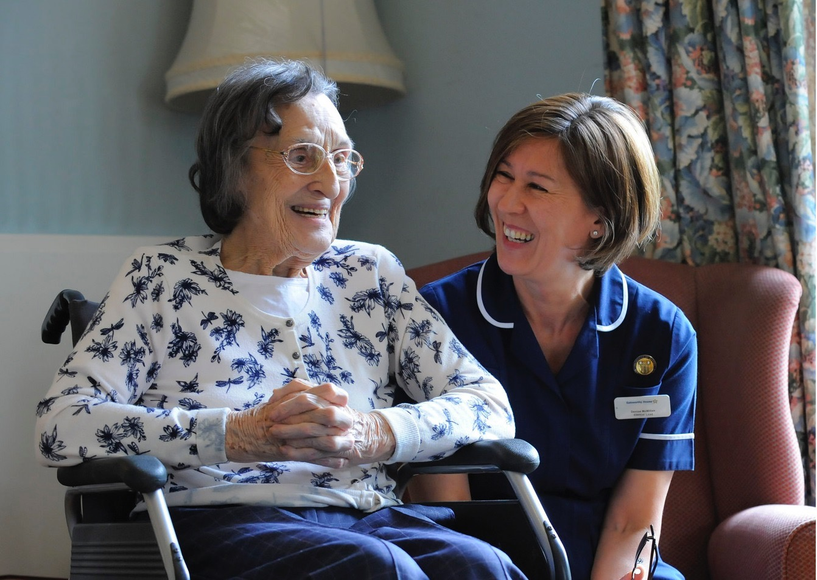
The future of adult social
care
regulation
Tracey Cockburn
Inspection Manager: Adult Social Care Hampshire (South Coast)
Phoenix Project 23 April 2015
1

Slide 2
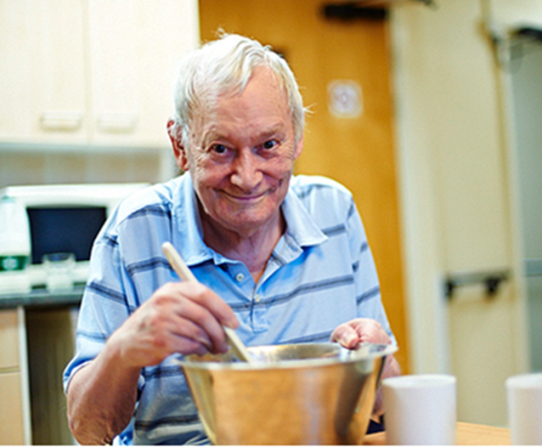
Working to improve quality of care
Together
Providers
Commissioners
Staff
Regulators
Public

Slide 3

CQC purpose and role
Our purpose
We make sure health and social care services provide people with safe, effective, compassionate, high-quality care and we encourage care services to improve
Our role
We monitor, inspect and regulate services to make sure they meet fundamental standards of quality and safety and we publish what we find, including performance ratings to help people choose care

Slide 4
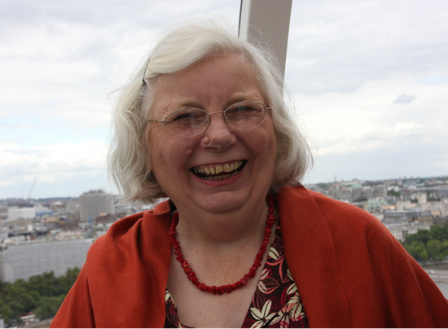
The Mum (or anyone you love) Test
Is it responsive to people’s needs?
Is it good enough for my Mum?
Is it
effective?
Is it safe?
Is it
well-led?
Is it caring?

Slide 5
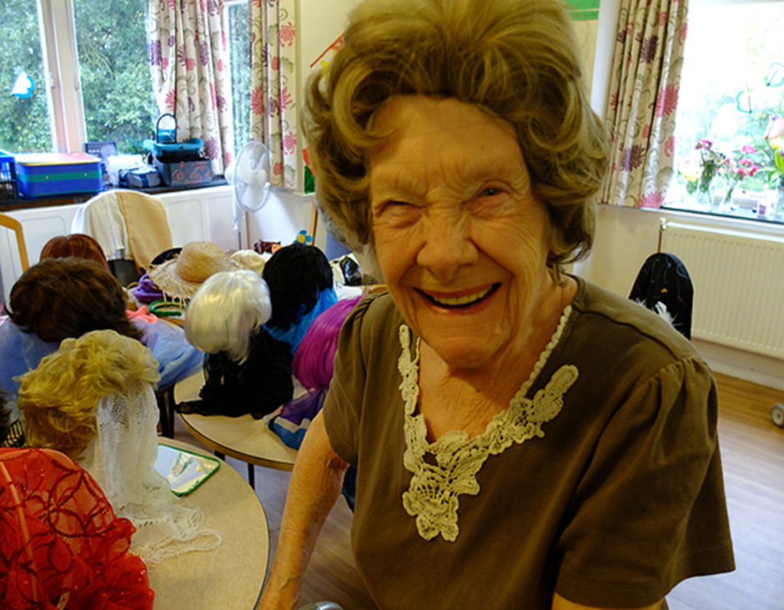

Regulation to inspire improvement
What we do:
Set clear expectations
Monitor and inspect
Publish and rate
Celebrate success
Tackle failure
Signpost help
Influence debate
Work in partnership

Slide 6

Regulation to inspire improvement
How we do it:
Five key questions
Respond to concerns
Key lines of enquiry
Specialist inspectors
Experts by experience
Ratings characteristics
Reports
Enforcement
Co-production

Slide 7

New for April 2015
Fundamental standards
  Fit and proper person requirement
  Duty of candour
Special measures
Scores on the doors
Market oversight

Slide 8

Duty of candour
Purpose
  Promotes adoption of openness and transparency in services
  Supports development of safety culture
Actions for providers
  Inform people when things go wrong
  Provide support, truthful information & apology
CQC
  Registration
  Inspection – existing key lines of enquiry

Slide 9

Fit and proper person requirement
Purpose
  Ensure directors or equivalents are held accountable for the delivery of care and
  They are fit and proper to carry out this role
Actions for providers
  Ensure recruitment of ‘directors’ tests whether candidates meet the requirement
CQC
  Registration
  Respond to concerns raised

Slide 10
Special measures
Purpose
  Ensure failing services improve or close
Actions for providers
  Use time available to improve service
CQC
  Services rated as inadequate will go into special measures
  Time limited period to improve
  If improvements made – out of special measures
  If no improvement – move to cancel registration

Slide 11
Scores on the Doors
Purpose
  Public able to see rating of service quickly and easily
Actions for providers
  Display ratings in service and website
  Suggest accompany with additional information
CQC
  Will provide template
  Inspection – check that rating is displayed

Slide 12

What will market oversight do?
Purpose:
  Protect people in vulnerable circumstances by spotting if a provider may fail – and make sure right action is taken
  CQC will:
  Monitor finances of ‘difficult to replace’ providers – 40-50
  Provide early warning to local authorities
  Assist with system response if failure occurs
  It will not:
  Either ‘bail out’ struggling providers, or pre-empt failure through inappropriate disclosure of information

Slide 13

What next for CQC?
Embedding transformation
Recruitment, including Experts by Experience and Special Advisers
Baseline rating for all services
Refining and evaluating inspection methodology e.g. speeding up reports
Strengthening registration
Improving efficiency, effectiveness and value for money
Looking to the future – integration, new models of care

Slide 14

A word about integration
Person-centred co-ordinated care not organisational focus
Continue to provide information about individual services
Set expectations for services to work with others
Undertake thematic reviews – Cracks in the Pathway
Look at experience of people in localities
‘Walk the talk’ – work in partnership with others – through co-production and addressing duplication
9

Slide 15
What are we finding?
Outstanding
Good
Requires improvement
Inadequate
18
1556
851
244
As at
12 April 2015
15

Slide 16

Reflections – part one
Power of the Mum Test
Importance of co-production
9

Slide 17

Reflections – part two
Social care is important…
…but really challenged:
        Expectations
        Demand
        Resources
        Scrutiny
9

Slide 18

Reflections – part three
Adult social care has the power to transform people’s lives
Celebrate the good
Challenge the bad
Be positive and honest
Work together
Outstanding care is achievable!
9

Slide 19
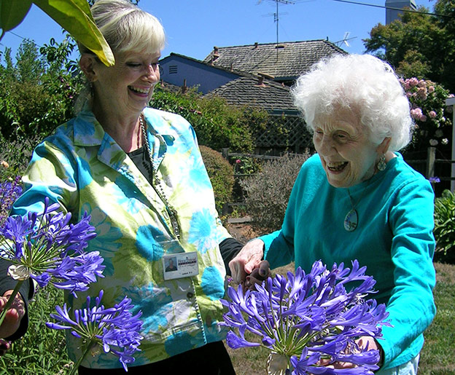
Outstanding care at home
‘Staff were given the opportunity to build meaningful relationships with people and ample time to meet people’s needs and provide companionship’
  Home Instead Senior Care,
  West Lancashire and Chorley
‘People felt care workers treated them with kindness and respect’
‘The registered manager delivered dementia training to the public – including bank and shop staff – to help them understand how to help people with dementia’

Slide 20
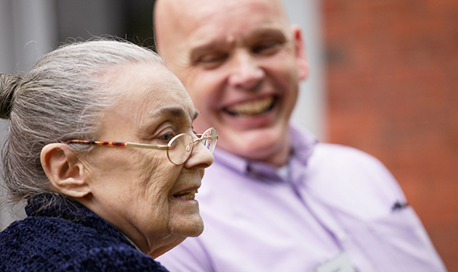
An outstanding care home
‘Relatives and friends visiting the home told us they only had positive experiences and praise for this service’
‘Staff told us that they would not like to work anywhere else’
Vida Hall, Harrogate

Slide 21
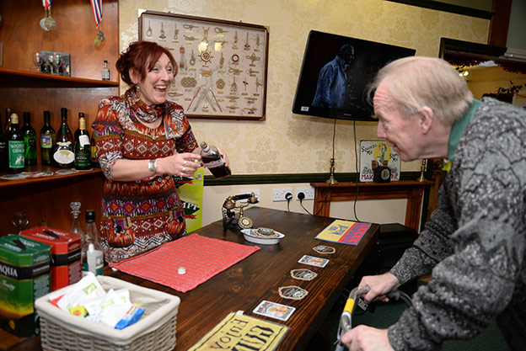
Another outstanding care home
"We didn't think we were outstanding. And perhaps that's why we were – I think it's because we see every single person as an individual. It is our privilege to support them to live the last years of
their life with as much happiness, love and security as we can give them."
Suzanne, Prince of Wales House, Ipswich

Slide 22

Join our team
Inspectors and Registration Inspectors
Permanent and secondment opportunities now available - please email:
recruitment@cqc.org.uk
Specialist Advisors
If you have specialist experience in Adult Social Care you could assist us in inspections – please email:
adultsocialcarerecruitment@cqc.org.uk
Experts by Experience
CQC is committed to hearing the voices of people who use services. Our new approach uses experts by experience. Contact us here:
expertsbyexperience@cqc.org.uk

Slide 23
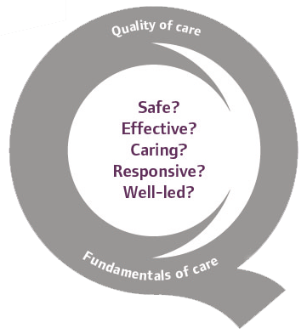

  Thank you
www.cqc.org.uk
enquiries@cqc.org.uk
@CareQualityComm
Tracey Cockburn
Inspection Manager for Adult Social Care - Hampshire
23

